Slide 1
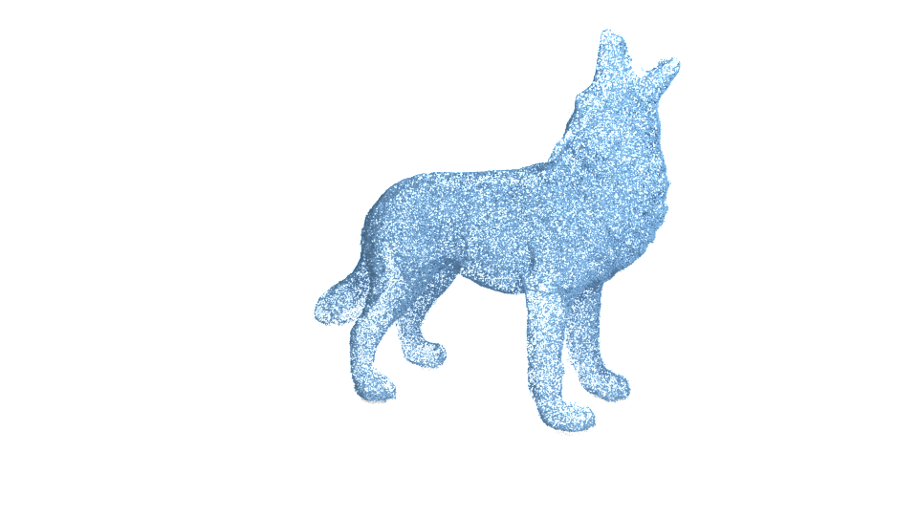
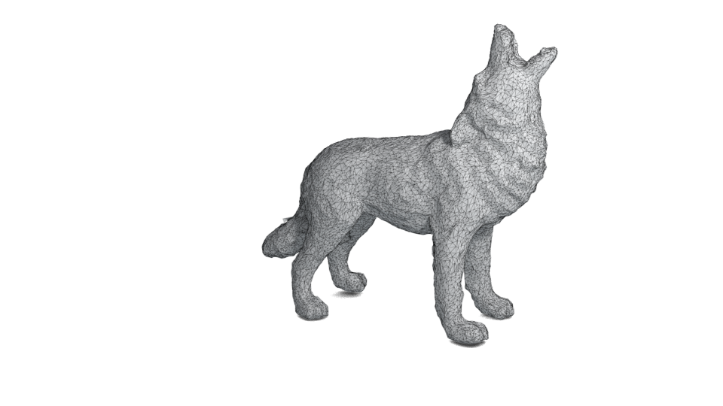
Point 2 Mesh
Josh Mitton, Sara Hahner, Milton Wong, Leila Elabbady
Mentor: Rana Hanocka

Slide 2
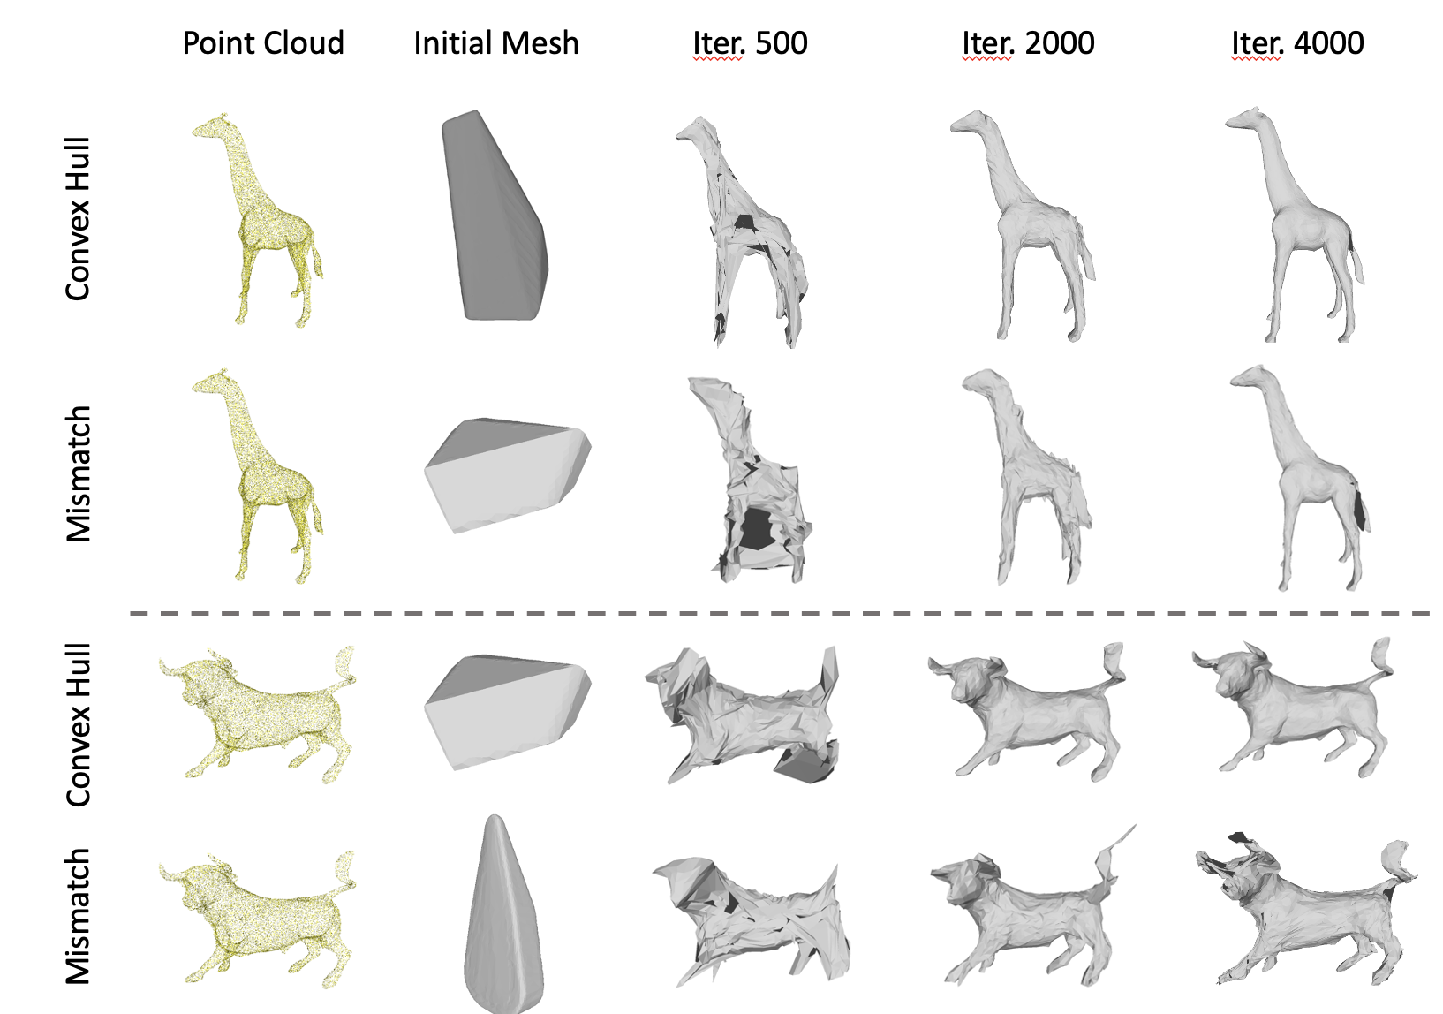
Labelled mismatch of initial mesh
Using the initial mesh of a different shape.
Requires more iterations to reconstruct
Not as good as using a well fitted initial mesh.

Slide 3
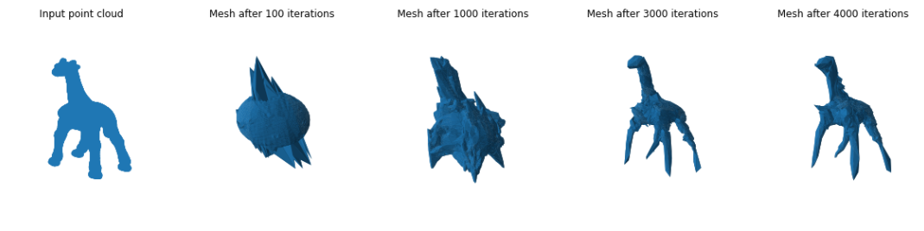
Spherical initial mesh
Start from a general spherical initial mesh.
Remove the need to create initial meshes that have some similarity with the target point cloud.
Resulting mesh looks like the target animal, but has some artifacts.
Possibly needs more iterations before upsampling is performed.

Slide 4
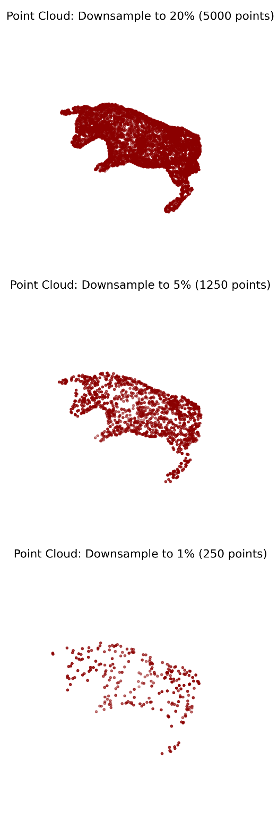
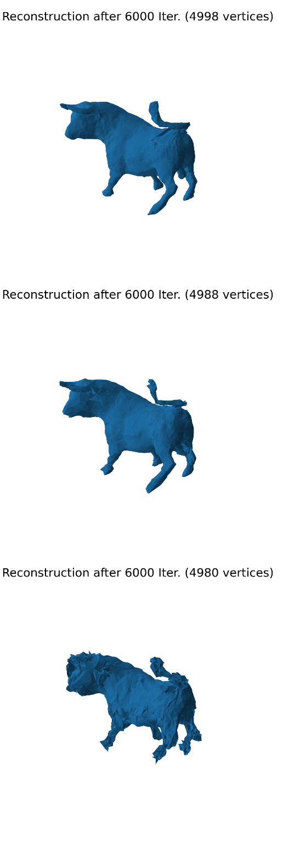
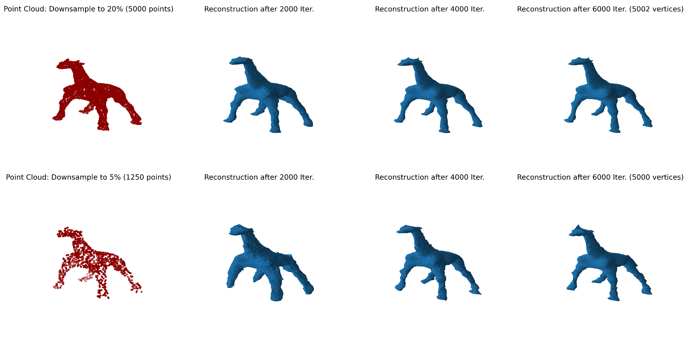
Downsampled initial point cloud
Reconstruct the surface using a down- sampled point cloud (to 20%, 5% and 1%).

Slide 5
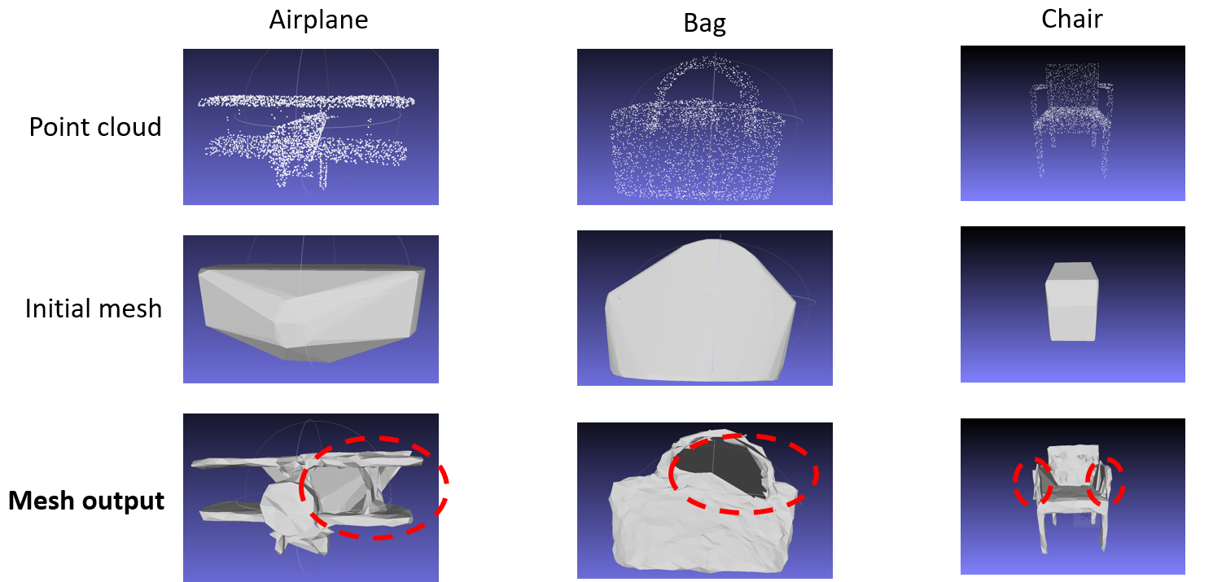
ShapeNet dataset
More challenging shapes. e.g. with fine-grained details, connected thin parts, diverse holes.
Point2Mesh still can get some pretty good mesh reconstructions.
One possible extension is to add extra mesh connectivity for better bridging the gap between target shape and deformable mesh.

